Slide 1
The Circuits of Matchings
Nicholas Crawford, Zachary Sorenson

Slide 2
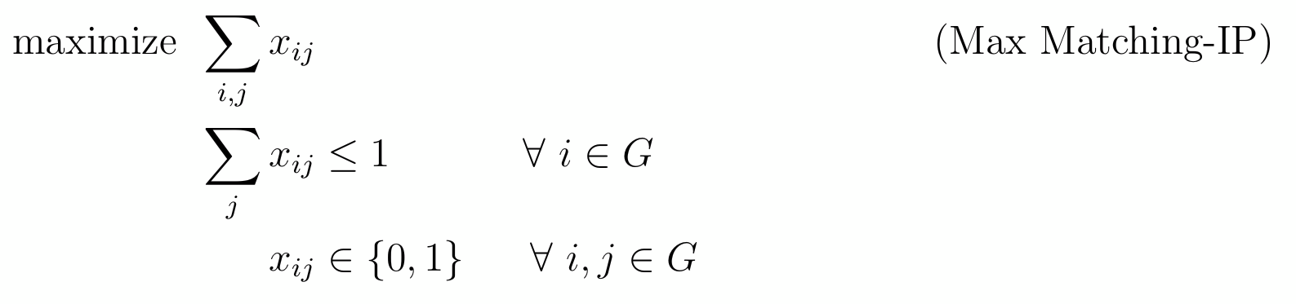
Matching Problem Formulation

Slide 3
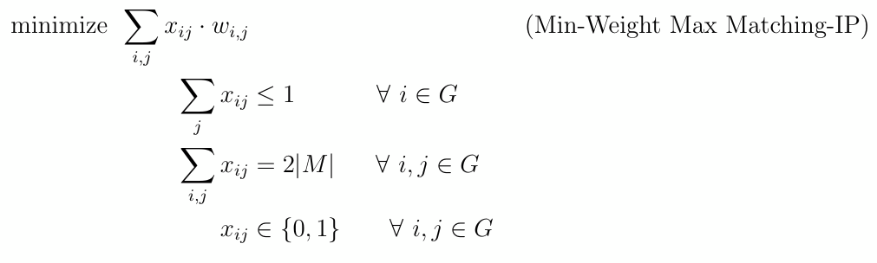
Minimum Weight Maximal Matching
Let M be a Maximal Matching

Slide 4
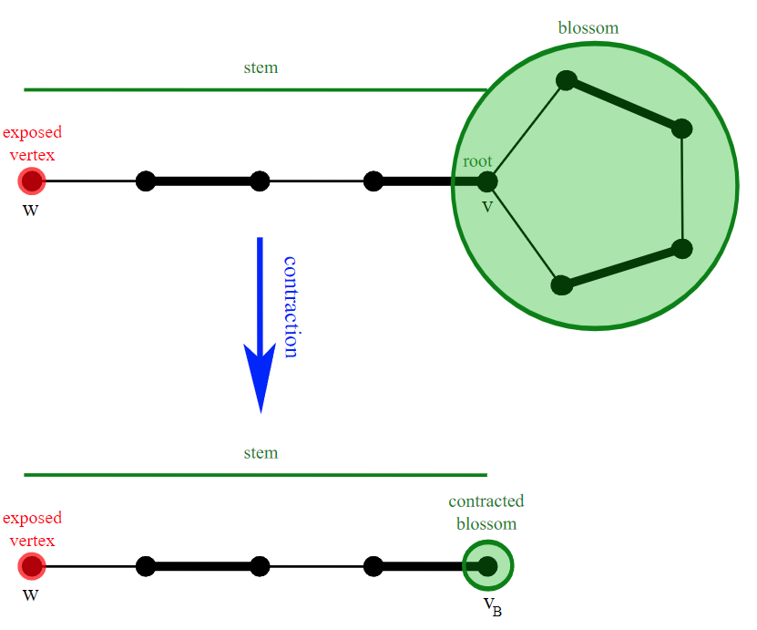
Blossom Algorithm
Start at your exposed vertex and traverse along the graph
Label your exposed vertex as an outer vertex “o”
Alternate between labeling each vertex as an outer vertex and an inner vertex
If two vertices are adjacent and both labeled with as an outer vertex, then we have an odd cycle
Contract the graph and continue
Once you have contracted all blossoms see if there exist an M-augmenting path of your new contracted graph.

Slide 5
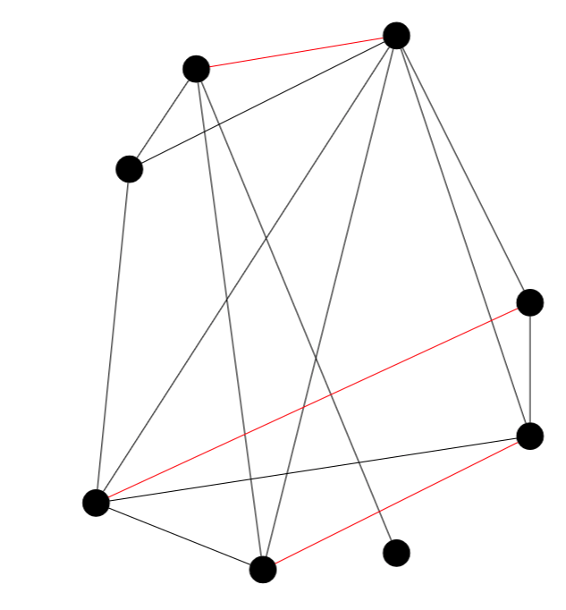
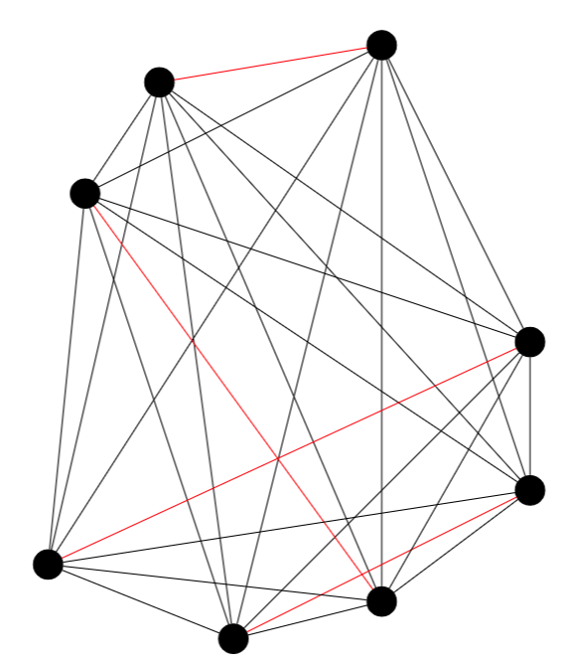
Extension to minimum weight matching
If our graph has an odd number of vertices, add an isolated vertex
Make a complete graph by connecting all nonadjacent vertices. Give the added edges weight zero
Extend every matching to a perfect matching. (This won’t affect the weight)
Replace every weight with its negative weight
Run our Blossom algorithm as a subroutine and find a perfect matching on our smaller graph

Slide 6

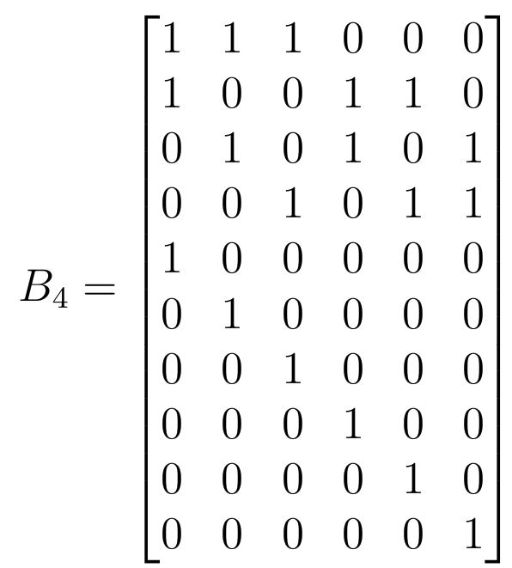
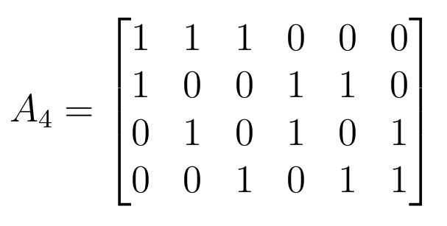



Slide 7
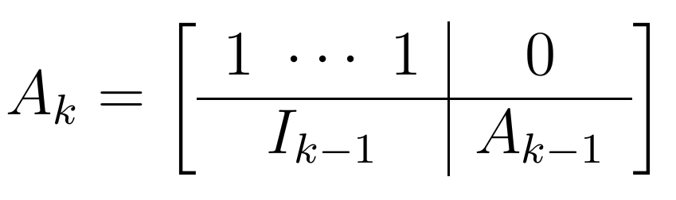

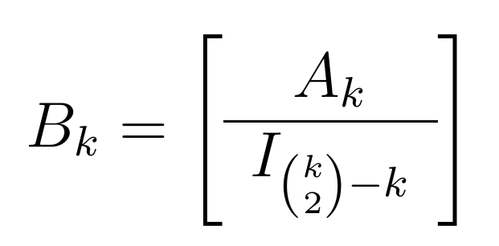
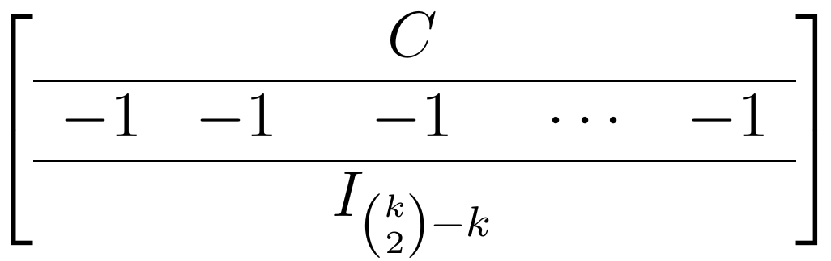
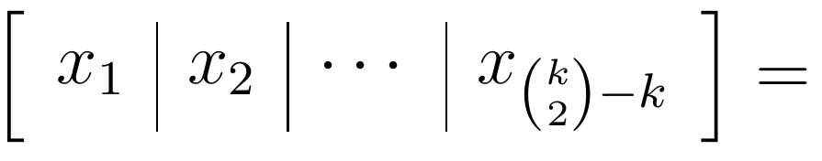
Generalization of Circuits on K-Vertex Complete Graphs

Slide 8
Proof Idea for A
Use induction on the number of vertices of our complete graph
Prove that every induced subgraph of a complete graph is complete
Use this to show the lower right block of A
Argue that adding a vertex makes a complete graph if we add enough edges
Enumerate the edges and vertices to get the A matrix

Slide 9
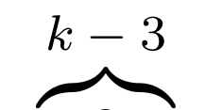
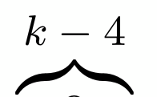
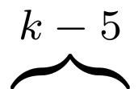
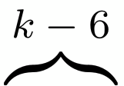
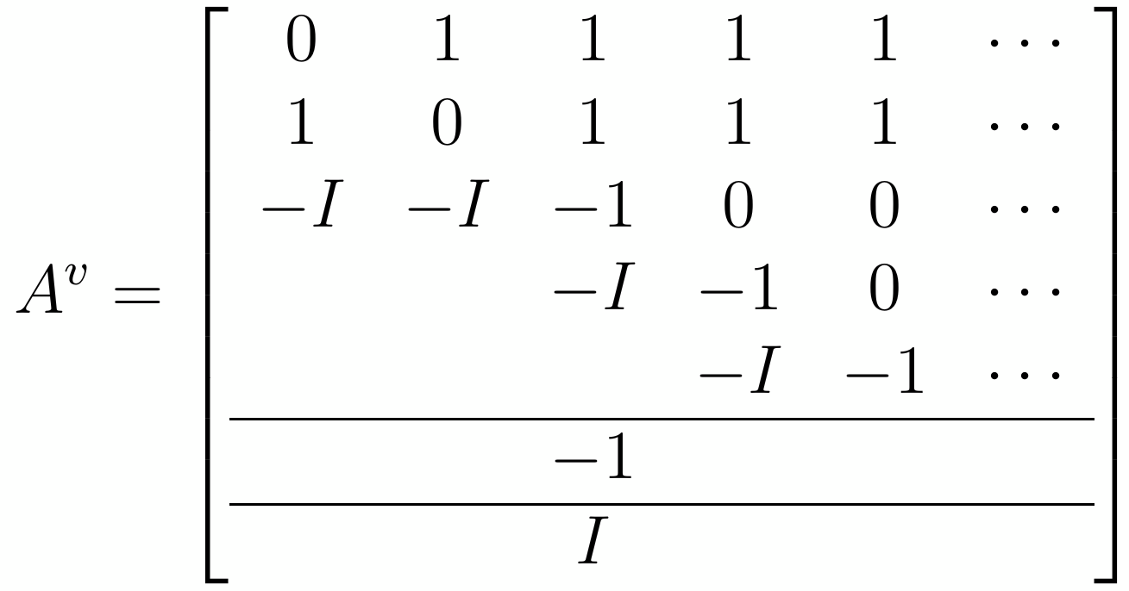
Characterization of Circuits

Slide 10
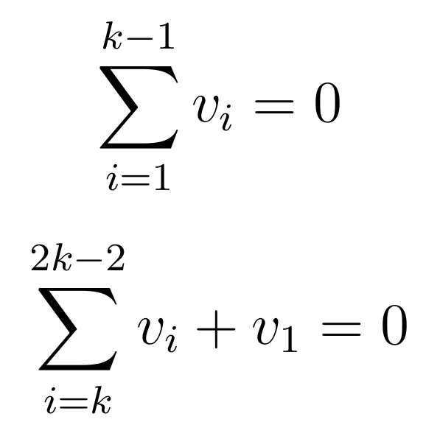
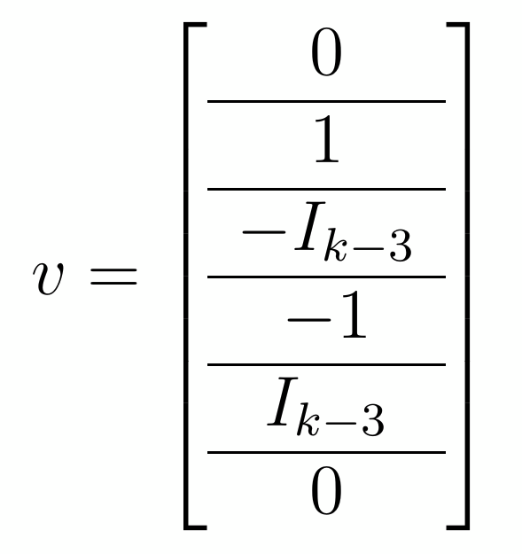
Proof for the characterization of circuits (First (k-3))

Slide 11
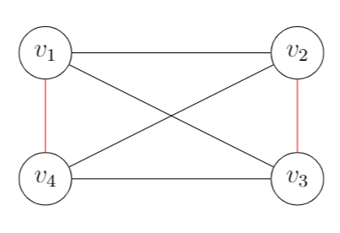
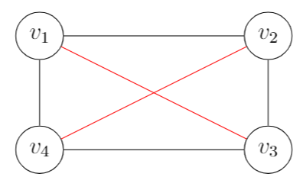
We talk the talk but do we circuit walk
What are the vertices of our polyhedra? Maximal Matchings
What does our algorithm do? Finds M-alternating paths
Our algorithm will take us from a matching of size M to another matching of size M
Applying our circuit allows us to travel to another vertex
We have then performed a circuit walk

Slide 12
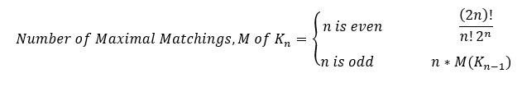
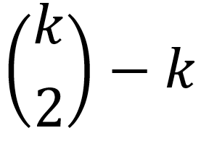
Further Generalizations
Questions: Is every maximal matching a circuit? No, but they could be a linear combination of circuits
Is every circuit a maximal matching? NO…probably
Number of Circuits =

Slide 13
References
Lovász, László, and Michael D. Plummer. Matching Theory, North-Holland, Amsterdam, 1986, pp. 357–382.
West, Douglas B. Graph Theory: Introduction to, Second Edition. Prentice Hall, 2001.

Slide 14
I am placing slides that I don’t think we need anymore after this slide!!!

Slide 15

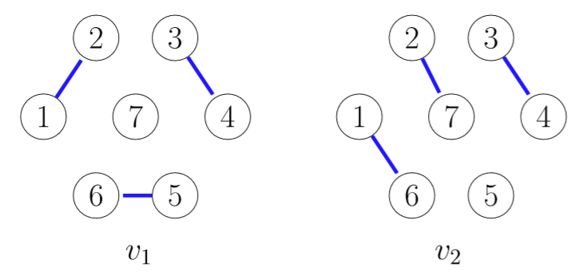
Matching Problem Vertices and Edges

Slide 16
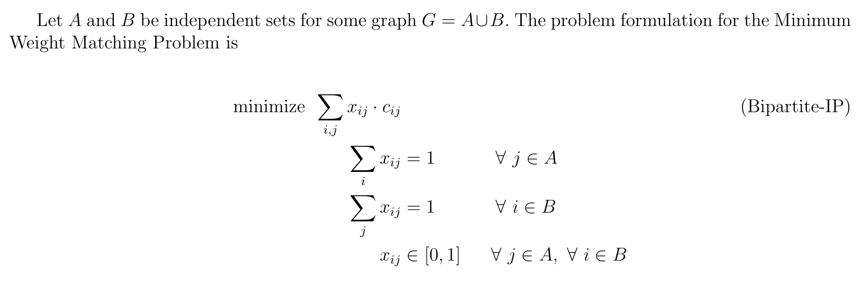
Bipartite Matchings

Slide 17
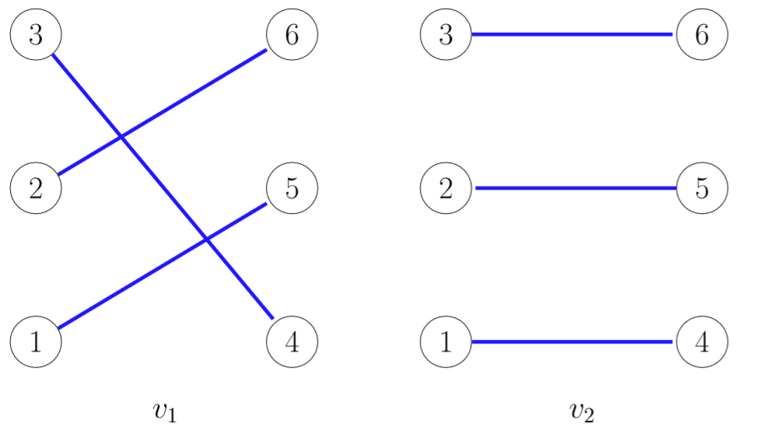
Bipartite Matching Problem Vertices and Edges

Slide 18
Formal Definition of Circuits

Slide 19
